Slide 1
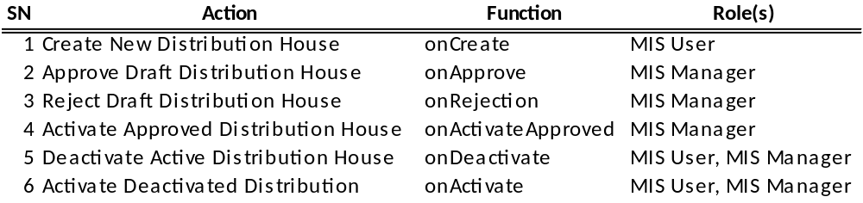
Distribution House Life Cycle
Inactive
onActivate
onCreate
onApprove
Draft
Approved
onDeactivate
onActivateApproved
onReject
Active
Rejected

